Slide 1
DIATwin

Slide 2
Outline
DIATwin Install
1. Decompress v1.1.1.zip
2. Software setup
3. Install others program
4. Add demo shortcut
5. Set function library environment variable
6. Reboot the PC
How to run
1. Open DIATwin
2. Update the model
3. Click the “Play” button
4. execution
Scene Display
1.Execute code
2.Emulator demo
3.Python code

Slide 3
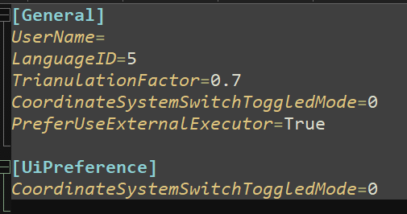
DIATwin Install
1. Decompress v1.1.1.zip
2. Software setup
(1) In “Installer” > 1_DIATwin
decompress DIATwin_v0.0.14_rev2.7z
run DIATwin_launcher.bat
(2) set “opentim.ini” in C:\Users\Public\DeltaDelectronics\DIATwin\opentim.ini
add “PreferUseExternalExecutor=True” in the last line in [General]

Slide 4
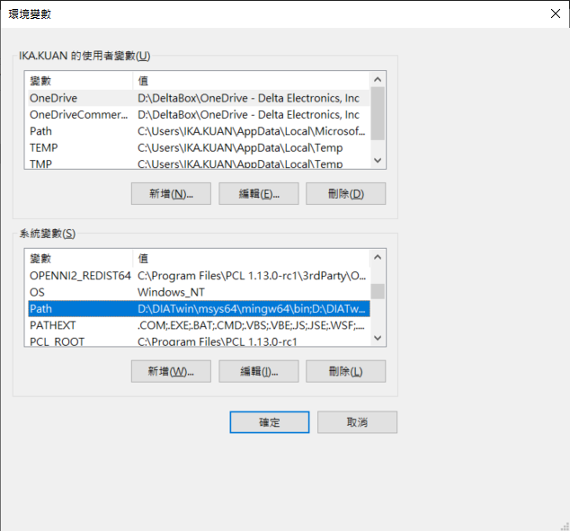
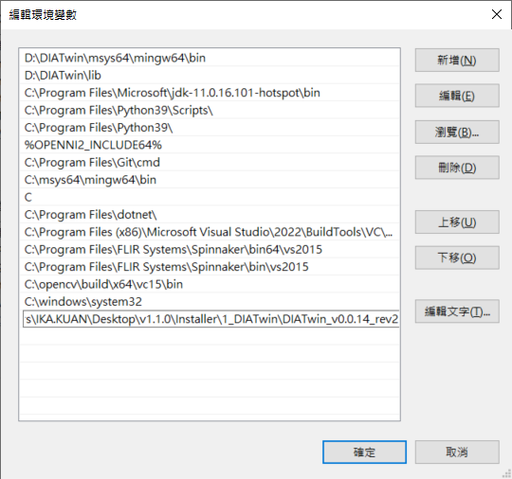
DIATwin Install
(3) setup environment variable
add the route where the .EXE is to the system variable “Path”

Slide 5
DIATwin Install
3. Install others program
(1) In “Install” > 2_MSVC
execute VC_redist.x64
(2) In “Install” > 3_Csharp
execute dotNetFx4._Full_x86_x64.exe
execute dotnet-sdk-7.0.203-win-x64.exe
execute windowsdesktop-runtime-6.0.16-win-x64.exe
(3) In “Install” > 4_Python
execute python-3.9.12-amd64.exe
add Python 3.9 to PATH
4. Add demo shortcut
(1) In DIATwin_release_1.1.0/pick_and_place_sdk/demo/bin/exe
(2) execute shortcut_creator.bat

Slide 6
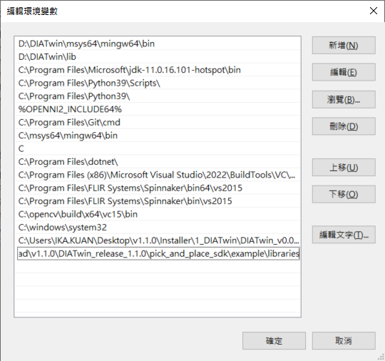
DIATwin Install
5. Set function library environment variable
add the route where the example/library is to the system variable “Path”
6. Reboot the PC

Slide 7
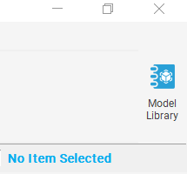
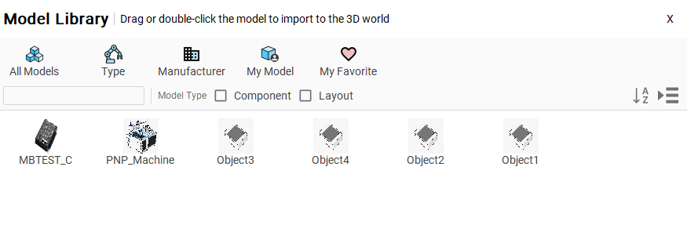
How to run
1. Open DIATwin
execute DIATwin_v0.0.14_rev2/DIATwin_launcher.bat
2. Update the model
(1) Put the .dt where in 20230906_PnP machine for DIATwin into C:\Users\Public\DeltaDelectronics\DIATwin\My Model\
(2) click the icon on the upper right : Model Library
(3) double click to upload the five objects

Slide 8
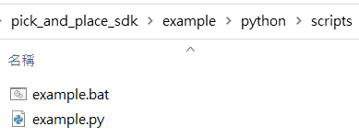
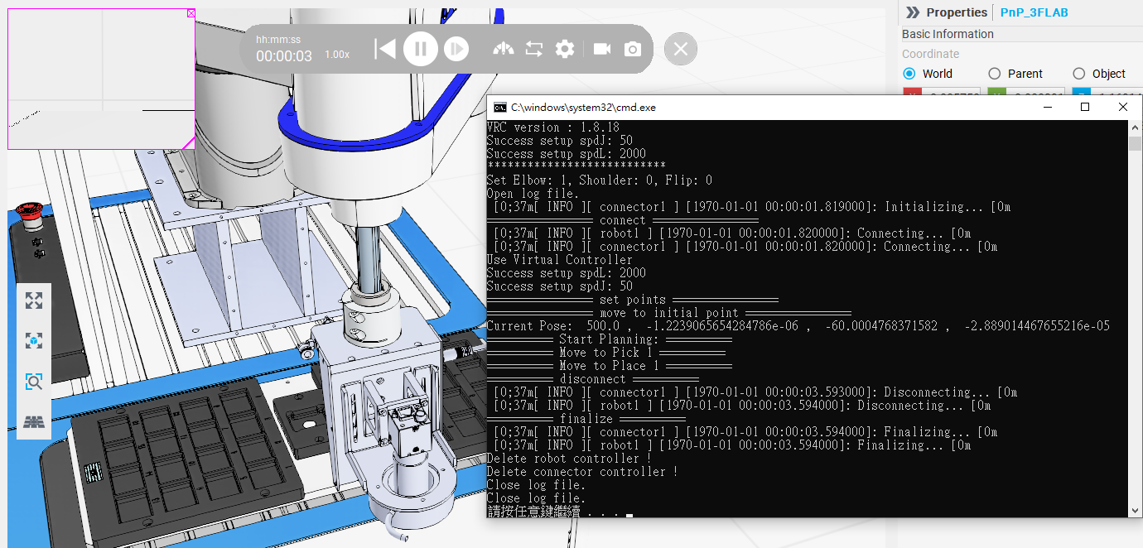
How to run
3. Click the “Play” button
4. execution
Into pick_and_place_sdk/example/python/scripts
execute example.bat

Slide 9
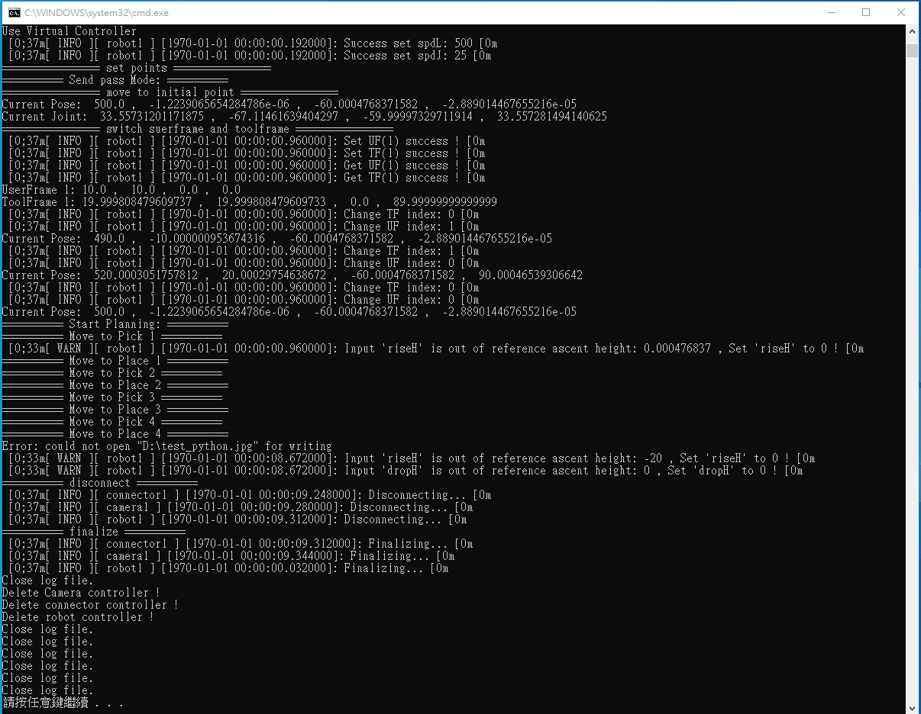
Execute code

Slide 10
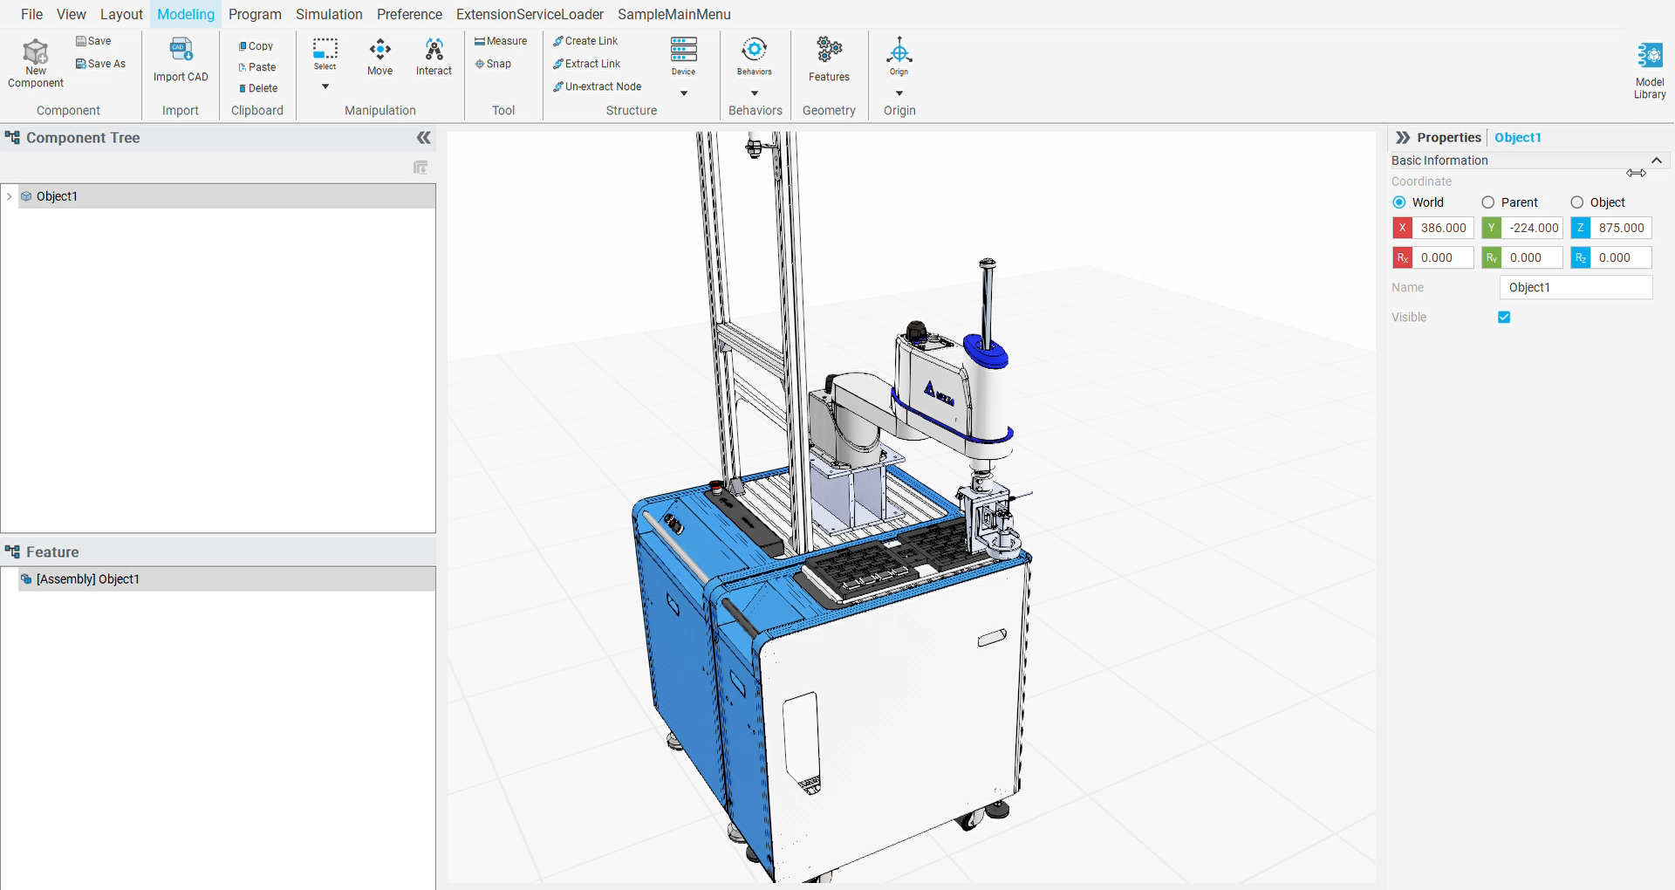
Emulator demo

Slide 11
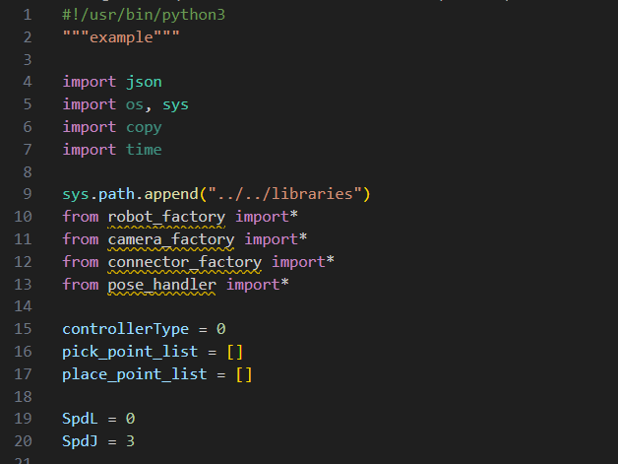
Python code

Slide 12
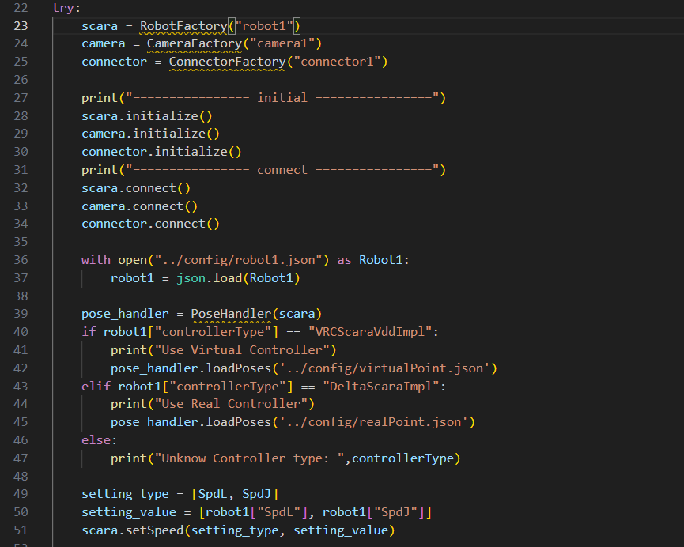
Python code

Slide 13
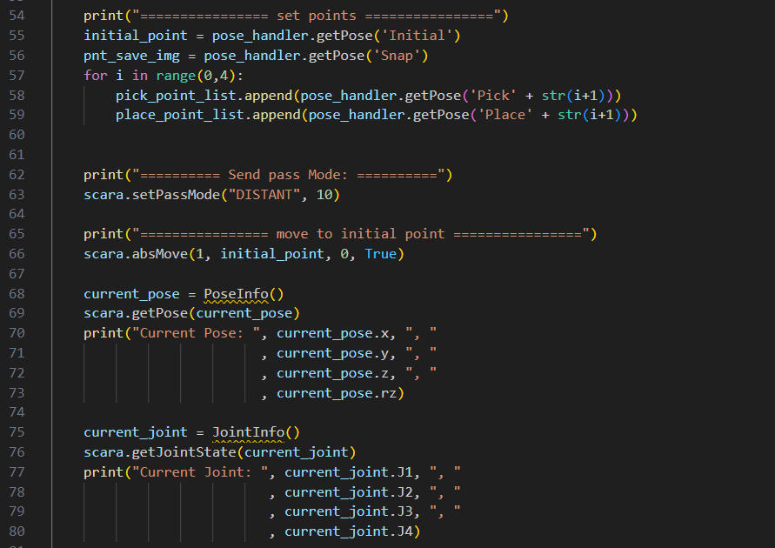
Python code

Slide 14
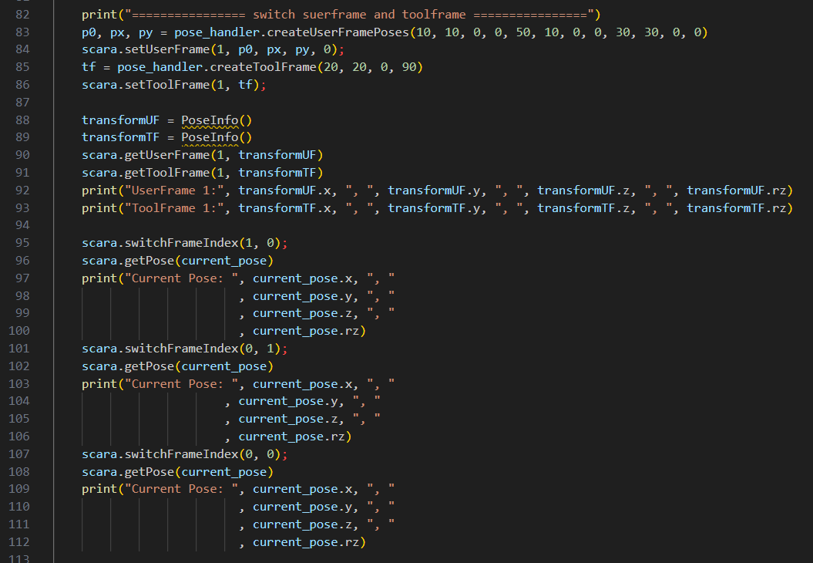
Python code

Slide 15
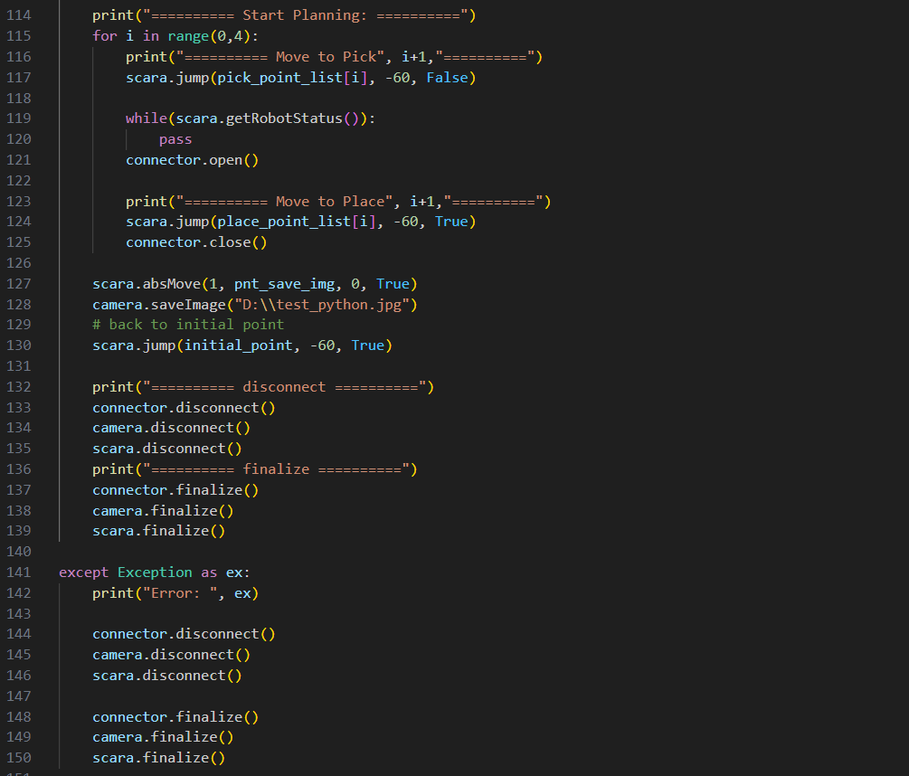
Python code

